Slide 1
Signals & Systems - Project
Amur Pal – Sannan Abbasi – Faiez Kazi – Junaid Ali

Slide 2
Signals & Systems - Project
Introduction
Overview of Task 1
Overview of Task 2
Mathematical Concepts
Industrial Applications
Major Results

Slide 3
Introduction
Our semester project consisted of two tasks.
Task 1 covers Frequency Division Multiplexing – an industrial technique that plays a crucial role in communication systems.
Task 2 covers the concepts of audio compression which is also important in data transmission while minimizing loss of information or quality.
Let’s move on to exploring each of the tasks and learn how we performed them using MATLAB.

Slide 4
Task 1 – Overview
We take 4 signals as input from the user which are passed through a designed lowpass filter of 3kHz.
Next, the signals are modulated with cosine signals with varying frequencies.
After that, we add the modulated signals together and they are plotted.
Having done that, the next step is to pass them through four bandpass filters with varying frequencies.
Finally, the signals are multiplied with cosine functions again, and then they are passed through a lowpass filter once more.
At the end, we retrieve the original signals with better quality and slight amplification.

Slide 5
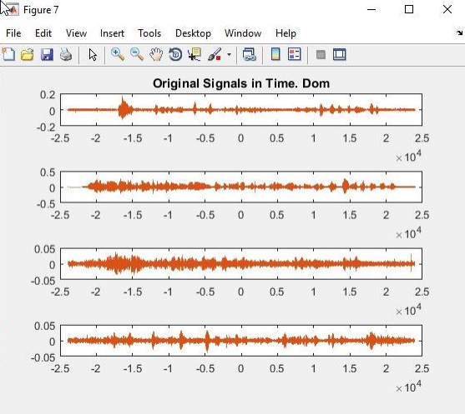
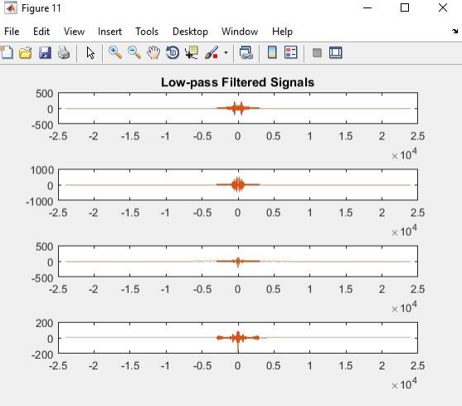
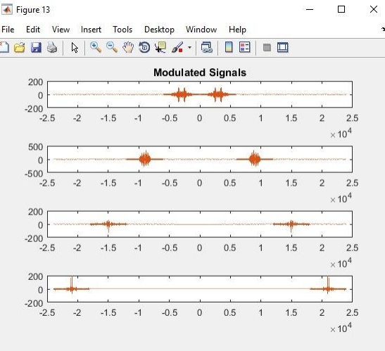
Task 1 – Overview

Slide 6
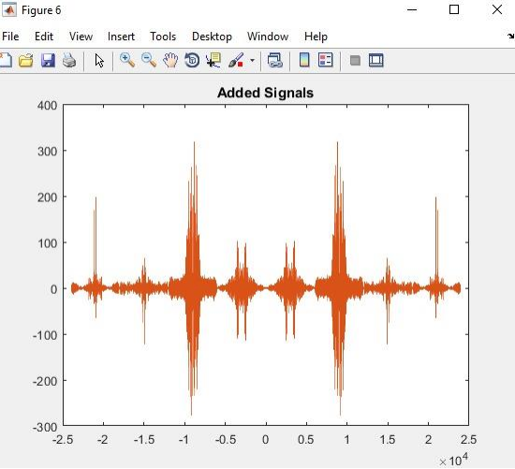
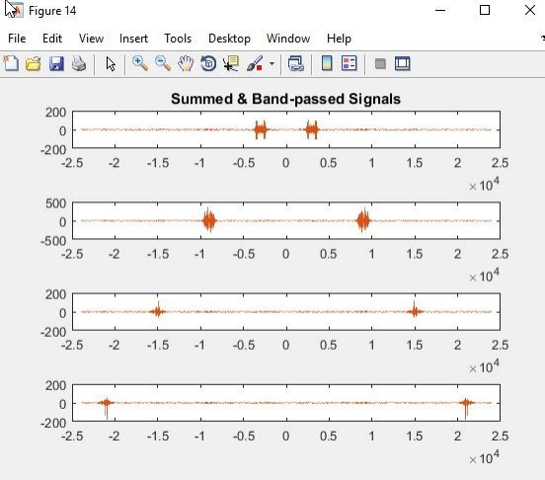
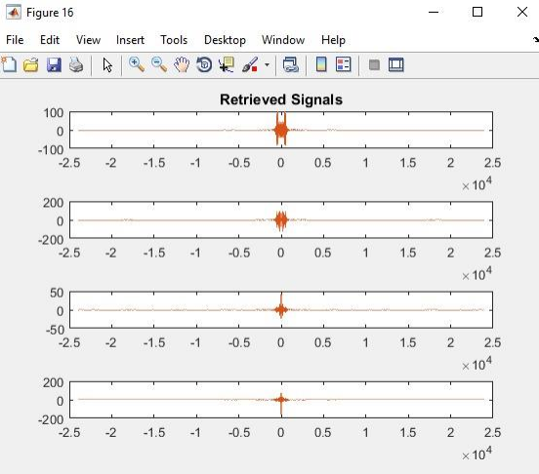
Task 1 – Overview

Slide 7
Mathematical Concepts – FDM
In Frequency Division Multiplexing, there are four frequency bands which transmit signals from the sender to the receiver.
These frequency bands are multiplexed and then transmitted, and later on, they are demultiplexed to regenerate the original signals.
These concepts of multiplexing and modulation are vital to telecom engineering.
Let’s say if they frequency bands are of 10kHz each, separated by 5kHz guard bands, then the capacity of the whole channel should be (10 x 4 + 5 x 3) 55kHz.
Modulation is the process of varying one or more properties of a carrier signal with a modulating signal which holds important information.
FDM is a technique through which you can divide the bandwidth of a communication medium into a series of non-overlapping frequency bands. These bands, as calculated earlier, carry data signals.

Slide 8
Industrial Applications – FDM
Long distance telephonic connection is made possible through FDM. Coaxial cables and L-carrier systems are the backbone of communicating thousands of voice signals over the globe.
AN/UCC-4 was a solid-state FDM system manufactured by Lenkurt in 1969. USA Air Force used UCC-4 to provide voice frequency communication to the Department of Defense.
FDM is useful in television broadcast.
FDM is useful in transmitting FM radio signals as well.
Cellular telephones also worked on the principle of Frequency Division Multiplexing.

Slide 9
Task 2 - Overview
At first, we graphed and plotted one of the original audio signals both in Time and Frequency domain.
Then, we took the major frequency components of the Audio Signal and removed the rest.
We reconstructed an audio signal by using this chipped off audio signal and compared it with the original
Where we found good enough result, that was it. (by varying the value of L for the frequency components)
In the end, we used SINAD as a tool to measure distortion and compared SINAD for different values of L.

Slide 10
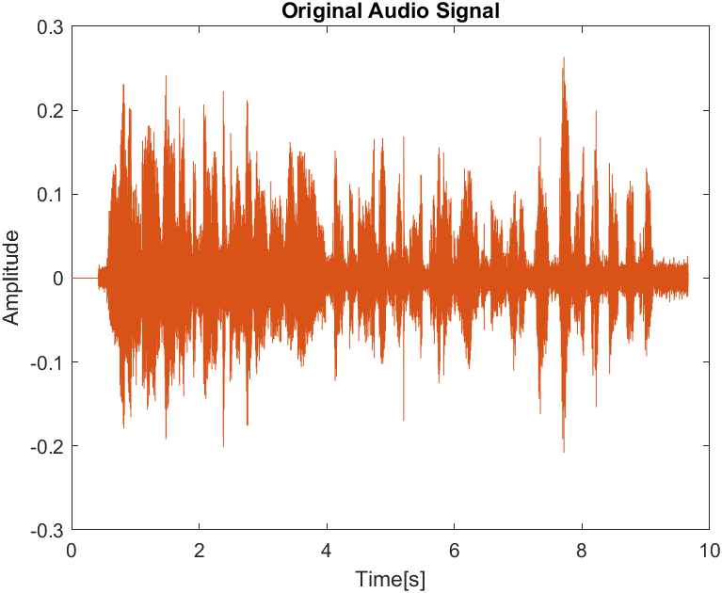
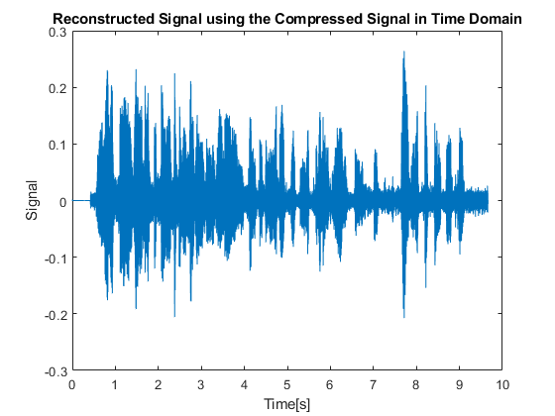
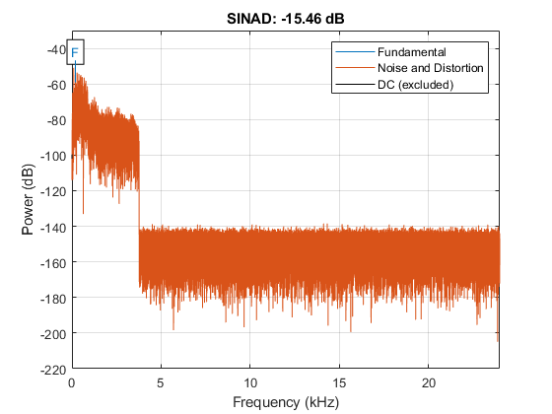
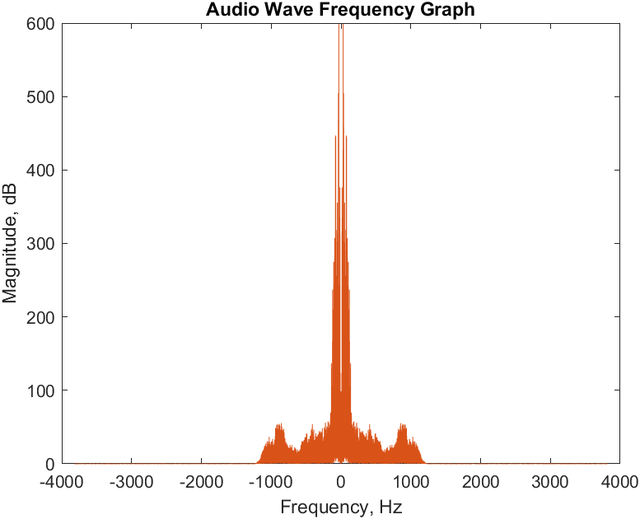
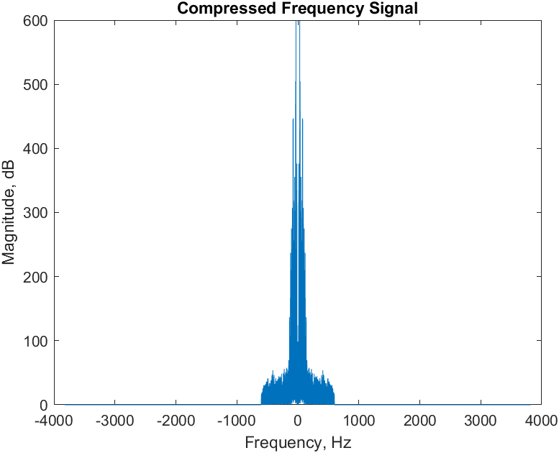
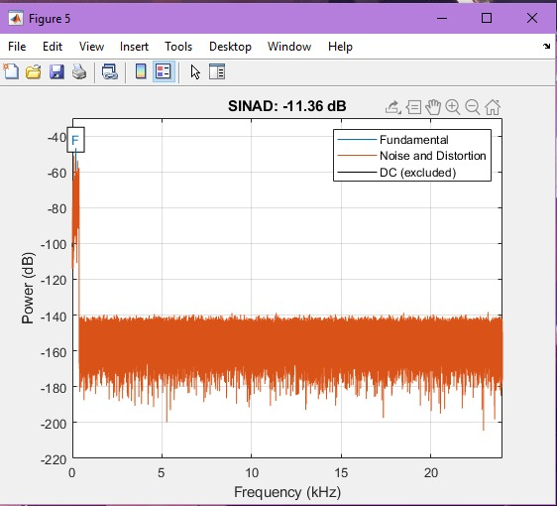
Task 2 – Overview

Slide 11


Task 2 - Overview
The lower the value of L, the greater is the compression ratio.
The reconstructed audio can be heard and is audible and has less distortion for a greater value of L.
While lowering the value of L, adds on to distortion and makes the signal almost inaudible.

Slide 12
Mathematical Concept – Audio Compression
Audio Compression is the process of lessening the dynamic range between the loudest and quietest parts of an audio signal. This is done by boosting the quieter signals and attenuating the louder signals.
Several compressor and limiter circuits are set in place to do so.
A sort of band pass filter is also used for audio compression (in our case too.)

Slide 13
Industrial Application – Audio Compression
Audio compression algorithms are implemented in software as audio codecs.
In industry, the main advantages of compression are reductions in storage hardware, data transmission time, and communication bandwidth. This can result in significant cost savings.
Using compression can make your tracks sound more polished by controlling maximum levels and maintaining higher average loudness.
Mainly used in the audio engineering industry for mixing music and other purposes.

